Slide 1
Unit 2: MS Word
Sheeba selvapattu
Assistant professor

Slide 2
Introduction to MS Office
MS-Office is the most up-to-date product of Microsoft which is mainly designed for Domestic/Official/Development purpose PC-Users.

Slide 3
Introduction to Microsoft Office?
It is a product of Microsoft Corporation and was first released in 1990. Microsoft Office is available in 35 different languages and is supported by Windows, Mac and most Linux variants.
It mainly consists of Word, Excel, PowerPoint, Access, OneNote, Outlook and Publisher applications.
Microsoft Office is a suite of applications designed to help with productivity and completing common tasks on a computer.
Notes:
You can create and edit documents containing text and images, work with data in spreadsheets and databases, and create presentations and posters.

Slide 4
Microsoft Office Common Applications
Microsoft Word :is a word processor that lets users make and edit text documents, such as reports, letters, and résumés and run spell-checks on writing
Microsoft Excel: is an electronic spreadsheet program that helps you store, organize and manipulate data by creating simple to complex spreadsheets
Microsoft PowerPoint: allows you to visually display information, using anything from basic slideshows to professional multimedia presentations
Microsoft Outlook: is a personal information manager mainly used for emails, but that can also be used to store calendars and contact information, manage tasks as well as organize meetings
Notes:
The most common Office applications are Word, Excel, PowerPoint, and Outlook. Other apps include Publisher, Access and OneNote.

Slide 5
Microsoft Publisher: is a graphic design app that gives users creating material for marketing or publications more options in the layout and design of their documents
Microsoft Access: is a database management system that allows you to link and use data from other sources, manipulate the data you’ve gathered in different ways, as well as create simple business applications
Microsoft OneNote: is a digital alternative to a paper notebook that allows you to create, organize and share your notes easily
Notes:
Microsoft Office is either available as a package or you can buy stand-alone Microsoft Office applications, such as Word or Excel, separately
Most basic packages come with Word, Excel, PowerPoint, and Outlook, while some also include other Microsoft Office programs, such as Publisher, Access, and/or OneNote.

Slide 6
Office Tools
Office Tools are a type of application software . They help the users to perform office-related tasks easily and efficiently.
Therefore, these tools help to create, manage, and manipulate large amounts of data and documents. Moreover, they help create presentations, reports, databases, etc.
Hence, users can perform such tasks repeatedly with less time and effort. These tools include software such as word processors, presentation tools, spreadsheets database systems, email tools, etc.

Slide 7
Different types of office tools are as follows:
1. Word Processor Tool
This software deals with text documents. It helps to create, format, manipulate, and save text files.
on the other hand, it can also be cloud-based such as google docs.
Certain examples are as follows:
MS-Word
WordPad
WordPerfect
Google Docs

Slide 8
2. Presentation Tool
This tool helps the user to break the information into small parts called slides.
Slides are basically small parts of a particular topic arranged on different pages.
Moreover, a series of these slides representing an idea to the audience is called presentation. Besides, this tool allows the user to present these presentations using the slideshow feature.
Furthermore, the slides can contain pictures, audios, videos, graphs, tables, etc.

Slide 9
Features of word processors:
A word processor tool can perform the following tasks:
Creating, saving, and editing text documents.
Formatting the text including features like font size, font color, alignment, WordArt, etc.
Spelling and grammar check
Adding images, clipart, screenshots, watermark to the text.
Setting header, footer, and margins to the text pages.

Slide 10
Certain examples are as follows:
MS-Excel
Google Sheets

Slide 11
3. Spreadsheet Tool
This software contains the data in the form of rows and columns.
The intersection of a row and column is a cell.
They store the data and have various formulas which in turn helps to analyze, calculate, and draw conclusions from data.
The business and financial sectors use this software more often.
They also contain additional features like graphs, charts, 3D graphs, tables, etc. for effective results.
Report presentation is thus quite easy considering these results.

Slide 12
Certain examples are as follows:
MS-PowerPoint
Lotus Freelance
Google Slides

Slide 13
Features of Spreadsheets:
Simple calculations like addition, subtraction, multiplication, finding the average, counting is quite easy. Moreover, simple formulas are used for these calculations.
Graphs and charts are quite easy to make based on the data in cells.
Formatting the data is quite easy and efficient.
It is easy to enter data in cells.
Logical comparisons can be easily calculated.

Slide 14
4. Database Management Systems
A database is a collection of related data or information in an organized form. A database management system is a tool that is used to store, search, extract, or delete information from a database..
Some database management tools help in handling records on the system like phone numbers, mailing lists, catalogs, etc. Examples are MS Access, Filemaker, dBASE, etc.
While some others help to manage large and complex databases. Examples are SQL, Oracle, etc.
Notes:
Moreover, we use them so that the operations which we perform on the database, are in an organized manner and safe

Slide 15
Certain examples are as follows:
MySQL
PostgreSQL
Oracle Database
Microsoft Access
MS-Access

Slide 16
Features of database management system
It can perform the following tasks:
Storing, reading, and updating the data.
Recovering damaged/lost data.
Authorization while accessing data.
Defining constraints on the dataset.

Slide 17
Functions of Office Tools
Organize files
Calculate and analyze data
Store, access, manipulate or delete specific data
Design graphics and animations
Make slideshows
Edit pictures and videos
Maintain attendance records
Manage records of school, library, railway, etc.

Slide 18
Frequently Asked Questions
Q1. What type of software is office tools?
a) System Software
b) Application Software
Q2. What are the different types of office tools
Q3. Give examples of office tools.
Notes:
A1. Application Software (Since they allow users to perform specific office related tasks)
A2. Wordprocessor Tool
Presentation Tool
Spreadsheet Tool
Database management system
A3. Examples are as follows:
MS-Word
WordPad
WordPerfect
Google Docs
LibreOffice Writer
MS-PowerPoint
Lotus Freelance

Slide 19
MS Word
Used to make professional-quality documents, letters, reports, etc., MS Word is a word processor developed by Microsoft. It has advanced features which allow you to format and edit your files and documents in the best possible way

Slide 20
Where to find MS Word on your personal computer?
Follow these simple steps to open MS Word on your personal computer:
Start → All Programs → MS Office → MS Word.
What are the uses of MS Word?
MS Word enables users to do write-ups, create documents, resumes, contracts, etc. This is one of the most commonly used programs under the Office suite.
How to create an MS Word document?
To create an MS Word doc, follow the steps mentioned above to open Microsoft Word. Then once the program is open, click on “File” followed by “New”. This opens a new doc where something new can be created.

Slide 21
Creating and Saving a Document:
Opening and Closing A Document
To open a file, select Open... from the File menu. In the dialog box, click on the filename and then on the Open button

Slide 22
Saving a Document
Save | Save As
When you save a new document for the first time, Word displays a dialog box. Select where you want to save your document and give it a name. When you save an existing document that you have been editing, the newly saved version is written over the older version. | This command always displays a dialog box where you can choose a document name and disk. Use the Save As command whenever you want to save a copy of the current document under a different name or in a different folder (or disk). The newly saved copy becomes the active document.
Notes:
Saving means preserve the content in a Secondary Storage device. It is a good idea to save your document right away and they continue saving every 5 or 10 minutes so if your computer crashes you will not be losing much. Your document and changes you make to a document are not saved to disk until you issue a save command. Saving is quick and easy. You should save often to minimize the loss of your work. Word has two save commands - Save and Save As. - that work similarly. Both are under the File menu.

Slide 23
Adding and Modifying Text
Entering Text
To enter text, just start typing. Word inserts the text you type at the insertion point. If you press a wrong key, use the Delete key to erase the mistake.
Word automatically starts a new line when you reach the end of the current line
To move the insertion point with the mouse, click the mouse in the desired location.
If the location you want is not visible, use the scroll bars to move up or down in the document.
To move the insertion point to the top of the document, press < Ctrl +Home >.
To move to the end of the document, press < Ctrl + End >.

Slide 24
Deleting Text
The Backspace key deletes one character to the left of the insertion point.
The Delete key deletes one character to the right of the insertion point. You can use these keys any time. To delete more than just a few characters, select the text and press the Delete key.

Slide 25
Undoing Mistakes
If you have accidentally deleted an important paragraph, use the Undo command under the Edit menu immediately (The keyboard shortcut is < Ctrl + Z >).
The deleted portion of the text is brought back. This command can bring back the deleted contents only if you have not pressed any other key in between.

Slide 26
Cut, Copy and Paste Text
Cut - The Cut command extracts the selected text and puts it on the Clipboard (a temporary storage area). The contents of the Clipboard are overwritten with each copy or cut.
This can be done either by selecting Edit from the menu bar and opting the cut option in it. Alternative usage of the short cut key is CTRL +X. Copy –
The Copy command puts a copy of the selected text on the Clipboard. By selecting the Edit from the menu bar and opting the Copy option in it. Alternative is usage of the short cut key is CTRL + C. Paste –
The Paste command inserts the Clipboard's contents at the insertion point. The text that has been selected using Cut/ Copy command will be pasted at the insertion point. Existing text moves to accommodate pasted text. By selecting the Edit from the menu bar and opting the Paste option in it. Alternative usage of the short cut key is CTRL + V.

Slide 27
Find and Replace:
Word allows us or helps us to search for a word in a document Find: Find is used for searching a word in your document.
1.On the Edit menu, click Find.
2.In the Find what box, enter the text that you want to search for.
Replace: Replace is used to replace the searched word by another text.
Click On the Edit menu, click Replace.
In the Find what box, enter the text that you want to search for.
In the Replace with box, enter the replacement text. The other options you have are Replace, Replace All, Find Next and Cancel.
Notes:
. Replace button replaces a word selected, at the first occurrence of the word in your document after the insertion point. Replace All button replaces all the searched words in your document. Find Next button searches for the next occurrence of the word being searched. Cancel button cancels the search process

Slide 28
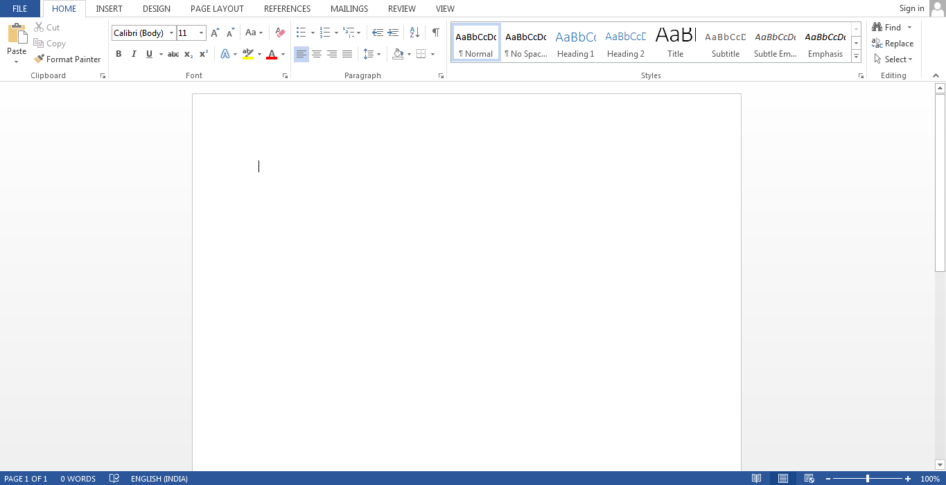

Slide 29
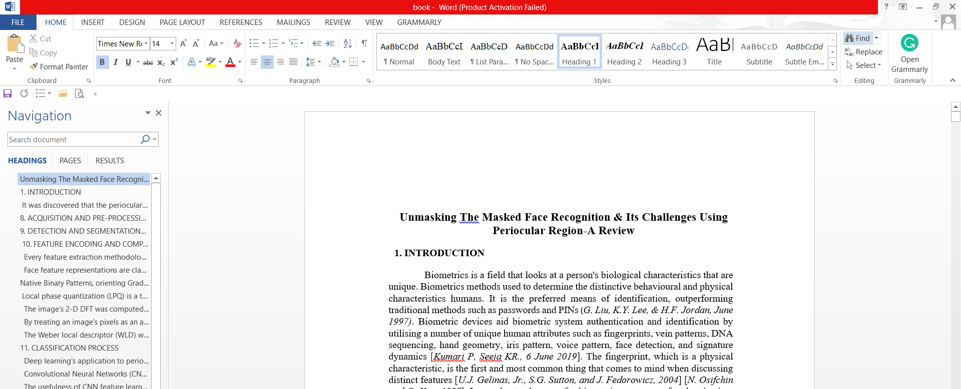
Find

Slide 30
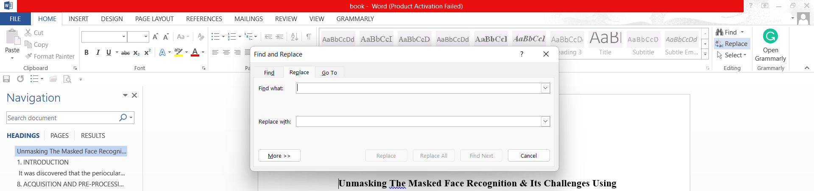
Replace

Slide 31
Replace button replaces a word selected, at the first occurrence of the word in your document after the insertion point.
Replace All button replaces all the searched words in your document.
Find Next button searches for the next occurrence of the word being searched.
Cancel button cancels the search process

Slide 32
Undo and Redo
When working in Microsoft Word you will often commit mistakes. Instead of manually trying to undo these actions you are able to rectify the mistake just by clicking the Undo button.

Slide 33
Redo
Redo You may accidentally click Undo too many times and thus, need to redo it. This command works exactly in the reverse of Undo command.
The shortcut key is Ctrl + Y

Slide 34
Microsoft Word shortcut keys(commands)
Shortcut | Description
Ctrl+A | Select all contents of the page.
Ctrl+B | Bold highlighted selection.
Ctrl+C | Copy selected text.
Ctrl+D | Open the font preferences window.
Ctrl+E | Aligns the line or selected text to the center of the screen.
Ctrl+F | Open find box.
Ctrl+I | Italic highlight selection.
Ctrl+J | Aligns the selected text or line to justify the screen.
Ctrl+K | Insert a hyperlink.
Ctrl+L | Aligns the line or selected text to the left of the screen.
Ctrl+M | Indent the paragraph.
Ctrl+N | Opens new, blank document window.
Ctrl+O | Opens the dialog box or page for selecting a file to open.
Ctrl+P | Open the print window.

Slide 35
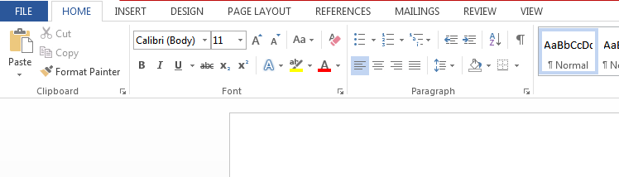
Features of MS Word
Now let us read more about the features and components of an MS Word doc file in detail.
The image given below shows the different elements and categories which are available in MS Word doc:

Slide 36
Home
This has options like font colour, font size, font style, alignment, bullets, line spacing, etc. All the basic elements which one may need to edit their document is available under the Home option.
Insert
Tables, shapes, images, charts, graphs, header, footer, page number, etc. can all be entered in the document. They are included in the “Insert” category.
Design
The template or the design in which you want your document to be created can be selected under the Design tab. Choosing an appropriate tab will enhance the appearance of your document.
Page Layout
Under the Page Layout tab comes options like margins, orientation, columns, lines, indentation, spacing, etc.

Slide 37
References
This tab is the most useful for those who are creating a thesis or writing books or lengthy documents. Options like citation, footnote, table of contents, caption, bibliography, etc. can be found under this tab.
Review
Spell check, grammar, Thesaurus, word count, language, translation, comments, etc. can all be tracked under the review tab. This acts as an advantage for those who get their documents reviewed on MS Word.

Slide 38
#Formatting
Character or Font Formatting
Paragraph Formatting
Document or Page Formatting
Section Formatting

Slide 39
Microsoft Word Formatting for Characters or Font
Font typeface (such as Calibri, Arial, Times New Roman)
Size
Style
Color

Slide 40
Paragraph Formatting
Line spacing
Indents
Bullets & Numbering
Borders & Shading

Slide 41
Document or Page Formatting
Document or page formatting usually determines the appearance of the entire document regardless of the size of the document and includes:
Margins
Page size and orientation
Headers and footers
Page numbering
Columns
and other page formatting instructions

Slide 42
Section Formatting
To change formatting in a document, insert a section break at the beginning of where you want the change.
Set up the formatting change just past the new section break. If you want to change formatting again, put in another section break.
If your changes are to be on the same page, choose the Continuous section break.

Slide 43
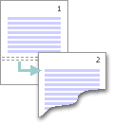
Use section breaks to layout or format a document
The Next Page command inserts a section break and starts the new section on the next page. This type of section break is useful to start new chapters in a document.

Slide 44

The Continuous command inserts a section break and starts the new section on the same page. A continuous section break is useful to create format changes such as a different number of columns on a page.

Slide 45
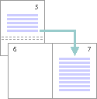
The Even Page or Odd Page command inserts a section break and starts the new section on the next even-numbered or odd-numbered page. To start document chapters always on an odd or even page, use the Odd page or Even page section break option.

Slide 46
#Language tools
Microsoft Word's language tools are more than just red or blue squiggly lines. There's help to choose alternative words, alternate languages, check and improve grammar, hyphenate documents and even test the document for readability.

Slide 47
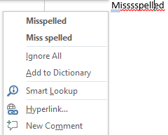
Spelling
We all know about the red squiggly line on misspelled words. Right-click to see possible correct spellings.
Notes:
Ignore All – Word will consider that word as correctly spelled in this document. There’s no option to ignore just one instance of a misspelled word.
Add to Dictionary – adds this word to your custom dictionary. It won’t be marked as wrong in any other documents.
Smart Lookup – new in Office 2016. Opens a Bing search for that word in a side-pane.

Slide 48
AutoCorrect
AutoCorrect is Word magically changing common spelling mistakes as you type. It’s different from the speller checker but related.

Slide 49
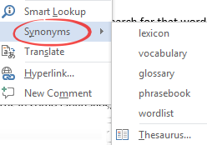
Thesaurus
In a paper thesaurus you looked up a word to see alternatives or synonyms
Microsoft Word has a thesaurus in some languages. Right-click on a correctly spelled word and choose Synonyms. Here we’re looking for synonyms of ‘thesaurus’:
Notes:
Click on a synonym to replace the current word.
Or choose ‘Thesaurus…’ to see more in a side-pane. If your computer is connected to the Internet you’ll see extra options.

Slide 50

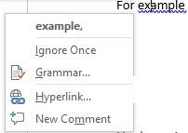
Grammar
The blue squiggly line checks not just for grammar but also common typing mistakes. For example, adding extra spaces between words.
Notes:
Ignore Once – removes the blue squiggly line with no change.
Grammar – opens the Grammar pane to show more options and examples. Like the Spelling pane, there’s a change language option.

Slide 51
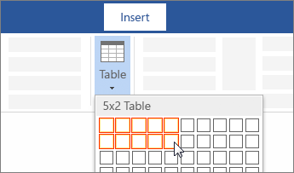
Table:
For a basic table, click Insert > Table and move the cursor over the grid until you highlight
the number of columns and rows you want.

Slide 52
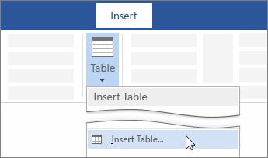
For a larger table, or to customize a table, select Insert > Table > Insert Table.

Slide 53
Tips:
If you already have text separated by tabs, you can quickly convert it to a table. Select Insert > Table, and then select Convert Text to Table.
To draw your own table, select Insert > Table > Draw Table.

Slide 54
Use a table or query as the data source
Open the source database, and in the Navigation Pane, select the table or query that you want use as the mail merge data source.
On the External Data tab, in the Export group, click Word Merge.
The Microsoft Word Mail Merge Wizard starts.
Select whether you want to create the link in an existing document or in a new document, and then click OK.
If you chose to link to an existing document, in the Select Microsoft Word Document dialog box, locate and select the file, and then click Open.
Word starts. Depending on your choice, Word opens either the document you specified or a new document.

Slide 55
How to use Mail Merge in MS Word?
Many day-to-day applications require similar documents containing similar text to be sent to a number of persons. These documents also have a typical common layout. Invitation letters sent to guests have a more-or-less common content and layout. Only the names of the recipients are different in these letters. One obvious way to generate such letters is to type all of them individually, putting the same amount of effort again and again. Another solution could be to copy the same block of text again and again onto the new letters. The names and addresses etc., which are different from each letter, can be entered separately in the documents. Though this method saves a lot of effort, it still requires proper caution. There should be a way where these kinds of documents can be prepared automatically. This task can be easily automated if we use the mail merge feature of a word processor. So, it is time we learnt the mail-merge feature of the word.

Slide 56
Components of mail merge:
The three main components of the merging process are the main document, the data source, and the merged document.
The main document contains the main body of your letter, field names, and merges instructions. The basic information within the main document remains equivalent.
The data source (or Recipients’ list) stores the knowledge that changes for every document. This information is inserted in the main document one by one. An example of the data source is a name and address list from which the program gets what you want to include in the main document.
The merged document contains the main text from the main document and data from a data source.

Slide 57
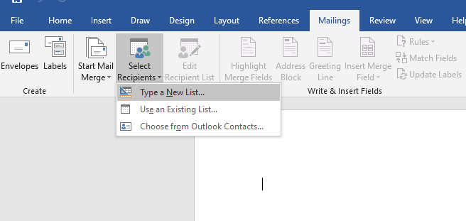
Steps for mail merger
Step 1:
Open MS Word and click on the command sequence: Mailings tab → Start mail merge group → Select recipients button → Type new List.

Slide 58
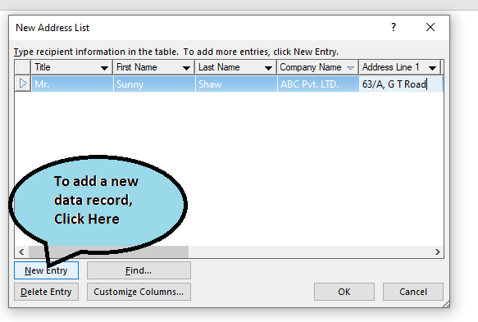
A dialog namely “New Address List” will pop up(as shown in the below image). Type here the desired data under the given headings. To add a new record, click on the “New Entry” button at the bottom of the dialog and click OK when you are done.

Slide 59
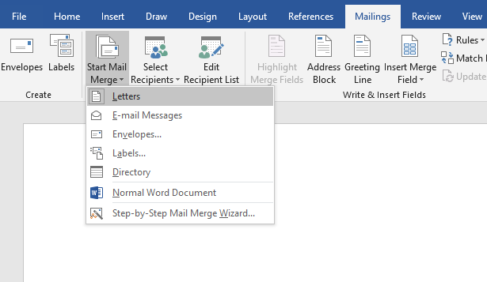
Step 2: Prepare Master Letter
The second step is to prepare our master letter for use in the mail merge. Before we enter all the letter text we’d like to link this Word file to our list of names.
Create a blank word document.
Click Mailings tab → Start Mail Merge group → Start Mail Merge → Letters command.

Slide 60
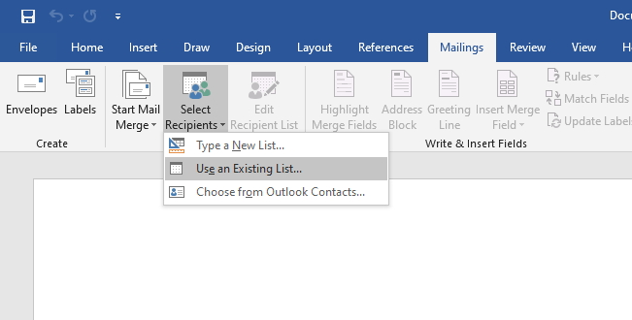
Then click the Mailings tab → Start Mail Merge group → Select Recipients button → Use Existing List command.

Slide 61
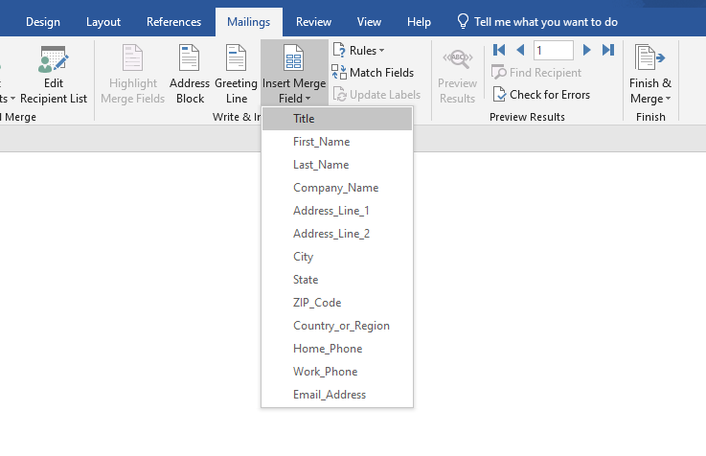
Now we can start typing the letter.
Now we would like to add the name and address and other details for the people on the list.
Mailings tab→ Write & Insert Field group → Insert Merge Field button.
A pop-down will appear showing all the table headings, so choose Title and press the spacebar to create a space.

Slide 62
Then do this again and choose FirstName, followed by a space (i.e., press only spacebar key and no other key); then choose LastName but this time press the Enter key to create a new line. Then repeat the steps to choose the Address field, and press enter key.

Slide 63
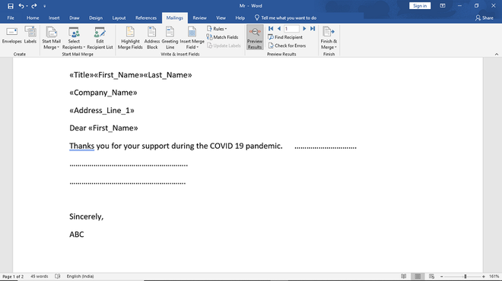

Slide 64
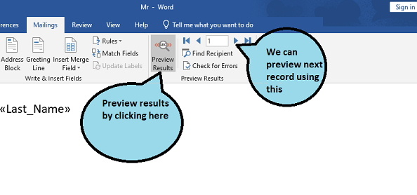
Step 3:
Before we actually carry out the merge, we must first preview what the merged letters will look like.
Mailings tab→ Preview Results group → Preview Results button

Slide 65
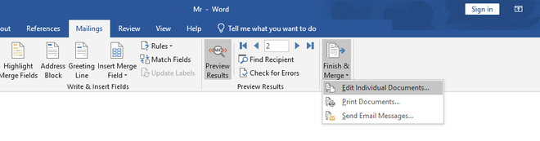
Once we are happy with the preview, you can carry out the actual mail merge.
To do this you click the Mailings tab → Finish group → Finish & Merge button and choose Edit Individual Documents.

Slide 66
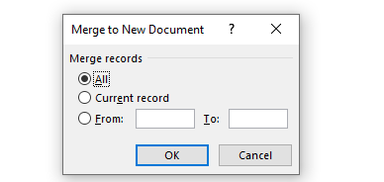
In the Merge to New Document panel, click All to create a separate letter for each person on the Names list. Word then creates a fresh document with as many pages as there are names on your list, and every page contains a wonderfully merged letter with all the correct individuals’ details.

Slide 67
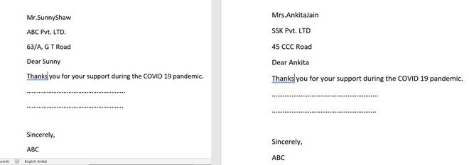
We can save this with an appropriate name, such as ABC.docx

Slide 69
You can filter, sort, and validate the data. Click OK to continue.
Click Next: Write your letter to continue. Follow the remaining instructions in the Mail Merge pane, and in step 5, click Next: Complete the merge.

